Slide 1

Vel Tech Rangarajan Dr. Sagunthala R&D Institute of Science and Technology
School of Computing
Department of Computer Science and Engineering
10211CS224 / FULL STACK APPLICATION DEVELOPMENT (JAVA)
PROJECT REVIEW : MILESTONE PROJECT – 2
Date: 20-04-2026
JOB PORTAL MANAGEMENT SYSTEM
SDG: SDG 9 – Industry, Innovation and Infrastructure
Presented By:
SYED SHAJAHAN – VTU25639–23UECS0890
Courses Handling Faculty:
Dr. S. Hemamalini – M.E., Ph.D.

Slide 2
INTRODUCTION
Job Portal is a web-based recruitment system designed to connect job seekers and employers in a single platform
Eliminates traditional manual hiring methods
Provides:
Fast job discovery
Easy application submission
Efficient hiring process
Built using modern UI (dark theme) for better usability
Supports both:
Students (job seekers)
Employers (recruiters)
1
2
3
4
5
6
7
8
9

Slide 3
PROBLEM STATEMENT
Traditional hiring systems suffer from:
Lack of centralized data
Manual tracking of applications
Students face issues like:
Difficulty finding relevant jobs
No proper tracking system
Employers face:
Difficulty managing multiple applicants
No proper filtering system
Existing systems lack:
User-friendly interface
Real-time updates Hence, a smart job portal system is required
1
2
3
4
5
6
7
8
9

Slide 4
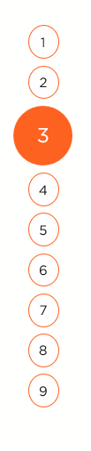
OBJECTIVE(S)
To develop a complete full-stack job portal application
To provide:
Easy job search functionality
Efficient job posting system
To implement:
Secure login authentication
Role-based access control
To design a:
Responsive and modern UI
To ensure:
Data consistency and reliability
1
2
3
4
5
6
7
8
9

Slide 5
PROPOSED SYSTEM
The system consists of two main users:
1.Student/User
2.Employer/Admin
Core Functionalities:
User registration and login
Job posting and browsing
Application management
Dashboard analytics
System ensures:
Data validation
Secure access
Smooth interaction
1
2
3
4
5
6
7
8
9

Slide 6
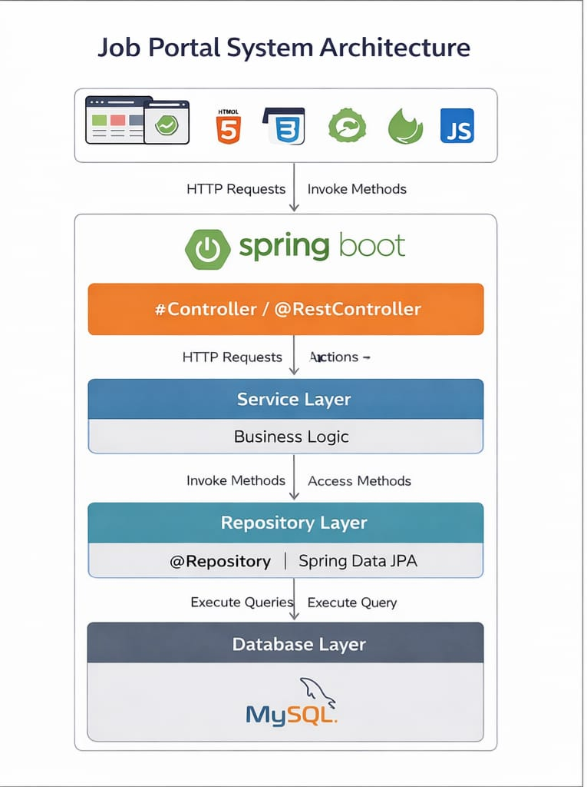
PROPOSED SYSTEM ARCHITECTURE
1
2
3
4
5
6
7
8
9

Slide 7
PROPOSED SYSTEM ARCHITECTURE
🔹 Input:
Users enter data such as login details, job search filters, and job postings.
This data is collected through the web interface (frontend).
🔹 Processing: The backend processes user requests and validates the input data.
It handles business logic like job posting, searching, and applications.
🔹 Database: Stores all system data including users, jobs, and applications.
Maintains relationships and ensures data consistency.
🔹 Output:
Displays results such as job listings, dashboards, and application status.
Provides real-time responses to users based on their actions.
🔹 Data Flow:
Data flows from user input → backend processing → database → output display.
Ensures smooth communication between all system components.
1
2
3
4
5
6
7
8
9

Slide 8
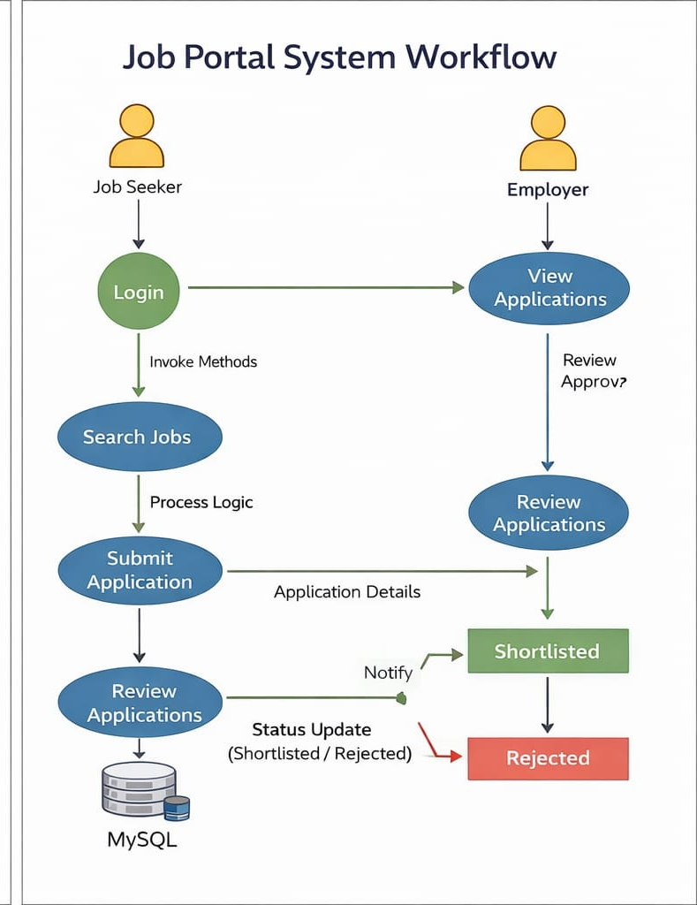
WORKFLOW
1
2
3
4
5
6
7
8
9

Slide 9
TECHNOLOGIES USED
Frontend: HTML, CSS, JavaScript, thymeleaf
Backend: Java, Spring Boot(SpringMVC)
Database: MySQL
Security: Spring Security
Tools: Visual Studio Code
Hardware/Software Requirements: MAC, Web Browser
1
2
3
4
5
6
7
8
9

Slide 10
MODULE DESCRIPTION
1
Module 1: User Authentication:
Secure login and registration
Handles secure login by verifying username and password
Role-based access (Student / Employer / Admin)
Module 2: Job Management:
Employers can post, edit, delete jobs
Module 3: Application Management:
Students apply for jobs, Track application status
Module 4: Search & Filter:
Filter jobs by:
Location
Skills
Experience
2
3
4
5
6
7
8
9

Slide 11
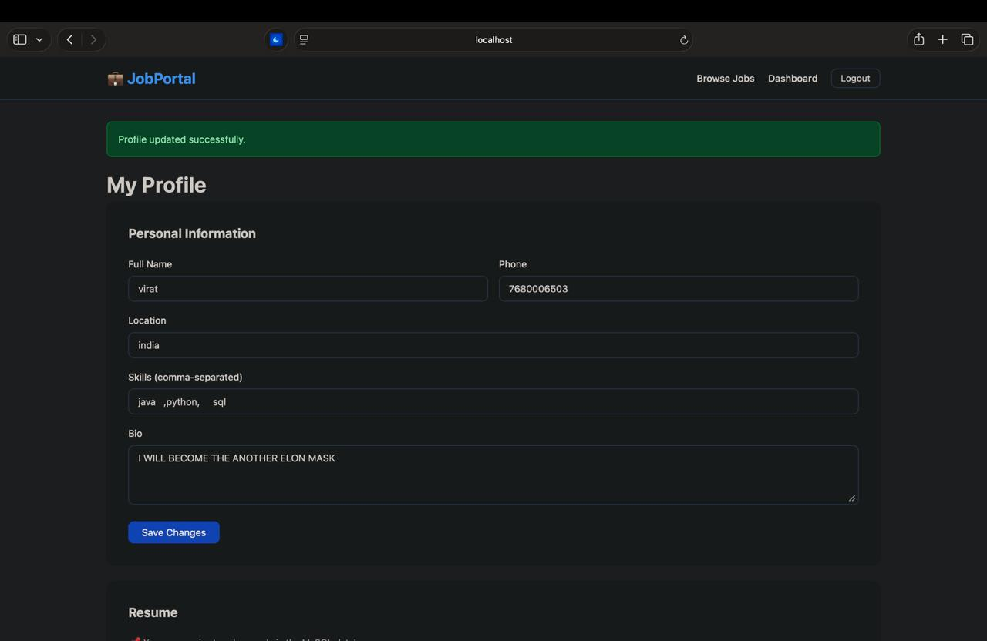
IMPLEMENTATION SCREENSHOTS
1
2
3
4
5
6
7
8
9

Slide 12
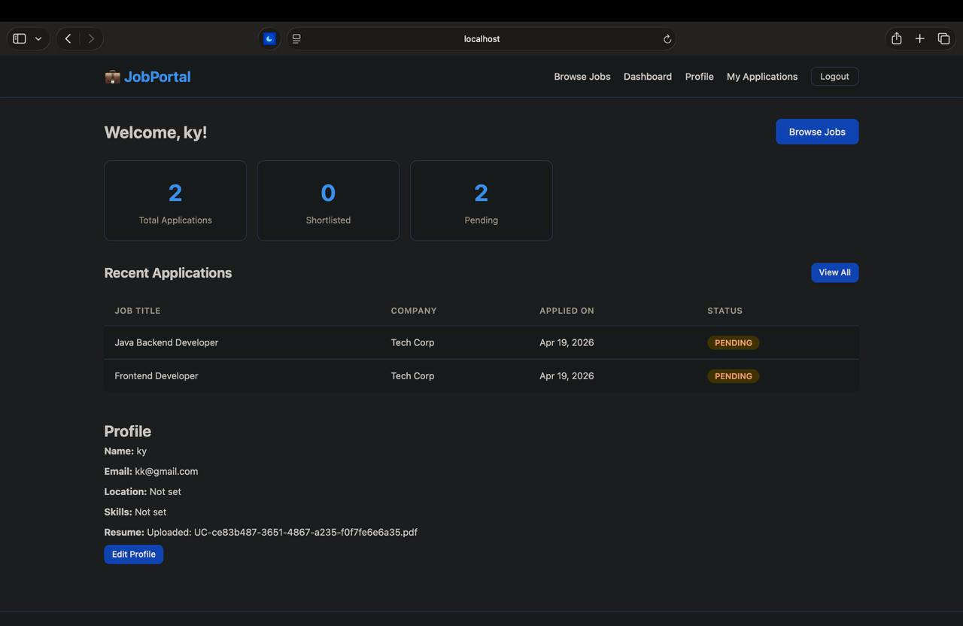
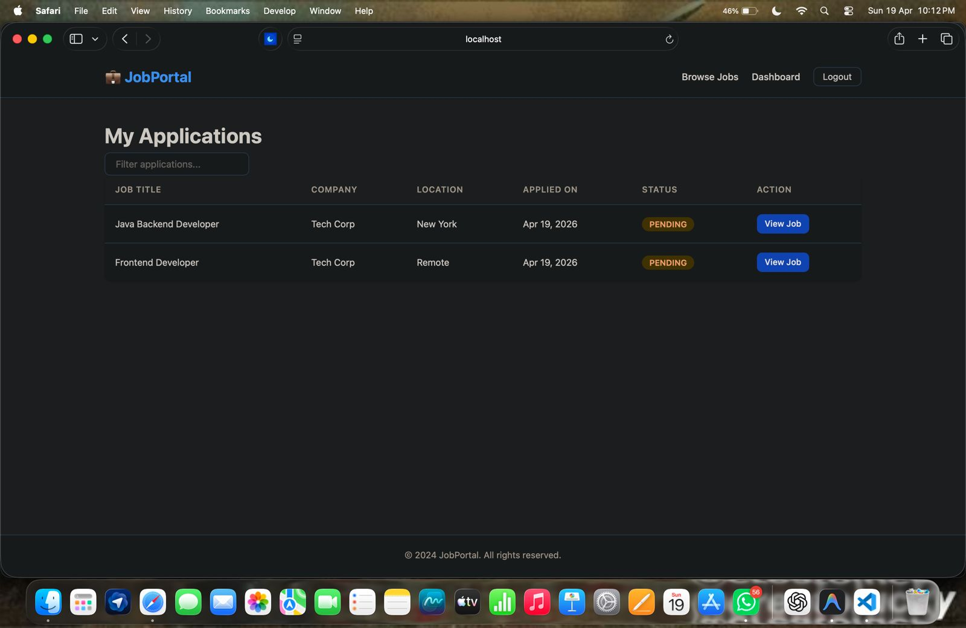
IMPLEMENTATION SCREENSHOTS
1
2
3
4
5
6
7
8(A)
9

Slide 13
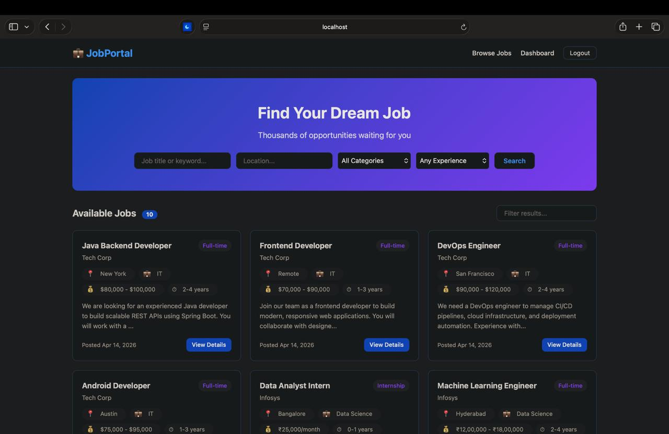
IMPLEMENTATION SCREENSHOTS
1
2
3
4
5
6
7
8(C)
9

Slide 14
ADVANTAGES & LIMITATIONS
ADVANTAGES:
User-friendly interface
Fast and efficient system
Centralized data management
Secure authentication
LIMITATIONS:
Requires internet connection
Basic features in current version
No AI-based recommendations
Limited scalability without cloud
1
2
3
4
5
6
7
8
9

Slide 15
Thank you

